Slide 1
Securing your Infrastructure with Azure Sentinel
Subtitle or speaker name
Notes:
Welcome to Securing your Infrastructure with Azure Sentinel.
My name is [Speaker name].

Slide 2
Agenda
Azure Sentinel data
Analytics
Visualize
Security orchestration
Notes:
Today we'll be running through Azure Sentinel from a few different lenses. If you've already deployed Azure Sentinel, some of this might be a repeat but I'll call out best practices where possible.
We'll start with Azure Sentinel data, including data storage in Log Analytics and how to approach workspace design in both a single tenant and multi-tenant environment. Next we'll cover the various sources of data that are available for ingestion into Log Analytics and analysis through Azure Sentinel and how that data can be encrypted.
Then, we'll talk about what you can do with your data once it's being ingested into Log Analytics. This includes leverage built-in detection rules and creating your own custom rule templates.
After that, we'll review visualizations and what you can do with Workbooks in Sentinel.
And finally, we'll close with Security Orchestration, Automation and Response, or SOAR.

Slide 3
Azure Sentinel data
Notes:
Let's get started with Azure Sentinel data sources.

Slide 4
Workspace considerations
Tenant
Single
Multiple
Data governance
Costs
Bandwidth
Storage
Notes:
The first thing we need to think about before we enable Sentinel is what workspace (or workspaces!) it is going to be enabled in. There's a lot of nuance here with single vs multi-tenant considerations and how data is governed and how costs manifest for both bandwidth and storage across your solution stack.
If you have multiple workspaces for performance, resiliency, or data sovereignty – are there any pitfalls to incident or alert correlation you need to be aware of? As you onboard other solutions or even as new functionality is added to existing solutions like Azure Security Center you need to understand where that data is going to reside and if it generates incidents, how are you going to keep the alert noise low?
Let's talk about some best practices that have been learned from existing customers.

Slide 5


Workspace Design (Single Tenant) One single workspace per tenant – many customers do this today!
Pros
Central pane of glass
Consolidates all security logs and information
Easier to query all information
Supported by all features of Azure Sentinel
Azure Log Analytics RBAC to control data access
Azure Sentinel RBAC for service RBAC
Cons
Data governance may drive limited scope
Can incur bandwidth cost cross region
Notes:
With all of the data for Sentinel ultimately stored in Log Analytics underneath, let's talk about workspace design in two contexts starting with single tenant.
Single tenant covers the majority of customers today. <click>
Let's start with the Pros. First, you'll get a single, central pane of glass. With all of your security logs and information consolidated into a single workspace, authoring queries becomes much easier and you don't need to worry about consistency in solution deployment and workspace schema getting in the way like you would with cross workspace queries – it's not that cross workspace queries can't be done – it's just that there's potentially more to know about KQL and the underlying workspaces you want to query.
Next, it's supported by all of the features of Azure Sentinel and you can control access to both Sentinel and the underlying Log Analytics data store using standard Azure RBAC. For Azure Sentinel, you can use built in roles like Owner, Contributor and Reader but there are also specialized roles such as Azure Sentinel Reader, Azure Sentinel Responder, and Azure Sentinel Contributor.
Log Analytics also has its own specialized roles, including Log Analytics Reader and Log Analytics Contributor. You can use the Log Analytics advanced role-based access control across the data in your Azure Sentinel workspace. This includes both role-based access control per data type and resource-centric role-based access control.
Keep in mind that other resources may be external to Sentinel and Log Analytics which drive how you use Sentinel. For example, if you leverage playbooks (which if you don't you should!) run in Azure Logic Apps. For that you'll want to look into the Logic App Contributor and Logic App Operator role assignments.
<click> On the Cons side, data governance can lead you to design multiple workspaces, with one of the most prevalent examples being data sovereignty. You should also consider data egress. For example, if you have Azure VMs in a region sending telemetry and operational data to a central workspace in another region, you will need to account for data egress charges.

Slide 6
Workspace Design (Single Tenant) Regional workspaces
Pros
No cross-region bandwidth cost
May be required to meet regulation requirements
Separate workspaces can add even more data control
Cons
No central pane of glass
Analytics, Workbooks, etc. must be deployed multiple times
Notes:
Now let's consider another model with regional workspaces, again if you need meet a compliance requirement or even if you have varying RBAC needs on a workspace-by-workspace basis.
<click> On the Pros – there's no cross-region workspace charges, you get far more granular control over who can access what data, and perhaps most importantly you'll be meeting the regulatory needs of the business if required.
<click> There are some cons here though. One of the most obvious is you'll lose the single pane of glass. Another consideration is you'll potentially have multiple analytics rules. Analytics rules cannot query across workspaces so you if you want the same rule logic in multiple places, you'll need to duplicate it. Workbooks, both Azure and Jupyter and hunting across multiple workspaces is possible today.
There is a community driven PowerShell module which can help you create analytics rules and publish them to multiple workspaces using the Sentinel API if this is a path that you need to go down.

Slide 7
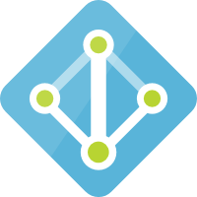




Workspace Design (Single Tenant)
Tenant
Tenant
Subscription
Subscription
Resource Group
Resource Group Region A
Resource Group Region B
Workspace
Azure Sentinel
Workspace
Azure Sentinel
Workspace
Azure Sentinel
Notes:
Let's run through what that would look like.
<click> For the first model, everything is very straightforward and clean – single workspace, single Sentinel resource, single resource group and single subscription.
<click> In the 2nd model, you're still single tenant but you now have multiple workspaces, multiple instances of Sentinel, and multiple resource groups. You could extend this further and even go for multi-subscription all under the same tenant.

Slide 8
What if I have multiple tenants?
Contoso |  |  |  |  | Northwind |  |  |  | Coho Winery
 |  |  |  |  | CENTRAL & SW | Prod. |  |  | Prod. | Staging | Test | Dev.
SALES, MKTG, & SERVICE |  | Prod. | QA | Dev. | EAST | Prod. |  |  | Prod. | Staging | Test | Dev.
LEGAL |  | Prod. | QA | Dev. | INCUBATION TEAM | Prod. |  |  | Prod. | Staging | Test | Dev.
HR |  | Prod. | QA | Dev. | NORTHWEST | Prod. | QA | Dev. | Prod. | Staging | Test | Dev.
Fabrikham |  |  |  |  | Proseware |  |  |  | Prod. | Staging | Test | Dev.
 |  |  |  |  |  |  |  |  | Prod. | Staging | Test | Dev.
VENDOR MGMT | Prod. | Training | Test | Dev. | VENDOR MGMT FOR REAL ESTATE | Prod. | Test/Dev. |  | Prod. | Staging | Test | Dev.
RETAIL | Prod. | Training | Test | Dev. | RETAIL | Prod. | Test/Dev. |  | Prod. | Staging | Test | Dev.
WEALTH MGMT | Prod. | Training | Test | Dev. | WEALTH MGMT | Prod. | Test/Dev. |  | Prod. | Staging | Test | Dev.
Notes:
This begs the question – What if I have multiple tenants with multiple subscriptions and multiple workloads? This muddies the waters, but it can still be accommodated easily using multi-tenant management features of Azure such as Azure Lighthouse.

Slide 9
Workspace Design (Multi-Tenant) One workspace per tenant Use Azure Lighthouse to delegate access to the central tenant
Pros
Same as single workspace single tenant
Cons
No single pane across all tenants
Notes:
So, for multi-tenant the easiest and recommended approach is to go with one workspace per-tenant and then use Azure Lighthouse to delegate access to that tenant.
<click> Your Pro here is you get the same setup as a single workspace with a single tenant, <click> with a downside of you won't have a single or central pane of glass across all of the tenants that you have delegated access to.

Slide 10
Workspace Design (Multi-Tenant)
Optional, but not recommended
Ship logs from each tenant to a central tenant
Source → Event Hub → Logic App → Azure Log Analytics
https://docs.microsoft.com/azure/azure-monitor/platform/activity-log-collect-tenants
Incur costs for Event Hubs & Logic Apps
Data written via Logic App will be stored in a Custom Log (_CL)
Queries will have to be changed to support _CL
Notes:
There are some things you can do to bring the data to a single tenant – this is optional but is not recommended if you can avoid it most due to cost. It introduces operational overhead, potentially having to do custom development, and more.
If you do go down this path, you'll send up sending data from one or more source systems to an Event Hub, where it can them be processed by a Logic App or another custom application and then forwarded on to the centralized Log Analytics workspace.
Beyond the costs you'll incur for both Event Hubs and Logic Apps, also consider the cost of storing the data multiple times – in the source system and maybe even a source Log Analytics workspace and then having it all duplicated to yet another workspace. And once again, don't forget about data egress.
Also consider that your telemetry will likely end up in a table for your custom logs. Custom Logs have _CL as a suffix on their table name and none of the built-in queries in Azure Sentinel for analytics rules or workbooks will be configured to point to custom tables. This means you will likely have to do a large mount of customization to existing queries or build custom queries to interrogate the logs in your custom table(s) within the Log Analytics workspace associated with Sentinel.
Again, this is not recommend, but it is possible.

Slide 11
Workspace Design (Multi-Tenant)
Tenant A
Tenant B
Tenant C
Subscription
Subscription
Subscription
Resource Group
Resource Group
Resource Group
Workspace
Azure Sentinel
Workspace
Azure Sentinel
Workspace
Azure Sentinel
Azure Lighthouse
Notes:
So what does this look like?
Each tenant gets its own workspace and you'll be granted delegated permissions through Azure Sentinel to be able to interact with each workspace. Note that in this model, multiple tenants could be multiple customers where each customer has their own tenant, or it could be a single customer who has provisioned multiple tenants in order to accommodate the business.

Slide 12



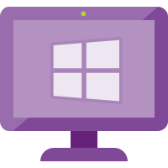
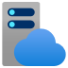


All the ways data gets in
Custom App
Appliances (Integrated)
Logic App – Send Data Connector
PUSH
Rest API
Threat Intelligence
(via Graph Security API)
MISP, Palo Alto….
Cloud Services
w/ Connector
O365, MCAS, AATP, MDATP, AWS
Workspace
Azure Sentinel
PULL
PUSH
Azure Services
(Diagnostic Logs)
AAD, AAD IP, Azure Activity, AIP, ASC, AzWAF, …
PUSH
Windows Agent
Linux Agent
Linux Agent – Configured for CEF
Appliances (CEF)
PUSH
Notes:
Now let's run through data connectors and all of the ways that you can ingest data into Azure Sentinel.
First, we have the Log Analytics workspace which has Azure Sentinel enabled on it.
<click> For Cloud services you'll find many connectors for Office 65, Microsoft Cloud App Security, Azure Advanced Threat Protection, and even external clouds like AWS. Cloud connectors are built-in to Azure Sentinel and can be easily enabled. Once enabled, Sentinel will regularly pull data from the external entity into your connected workspace. All of the connections leverage modern authentication and supported vendor APIs for data retrieval.
<click> Next we have Azure services. You'll find connectors for common services like the Azure Activity Log and Azure AD Sign-in Logs. Note that some connectors such as the Azure AD Sign-in logs do require access to premium licensing in Azure AD. For some services, you may not see a direct connector but if the diagnostic settings for the resource support sending data to Log Analytics then you can certainly ingest the data into your target workspace and then create queries, custom analytics rules, and queries as needed. Note that this is a push model from the source.
<click> Next we have the Azure Log Analytics agent which is available for both Windows and Linux servers and clients. This agent goes by a number of names – The Log Analytics agent, the Microsoft Monitoring Agent or MMA, and the OMS Linux agent. These also operate on a push model, with the clients through the agent writing data to a connected workspace.
<click> There's also a Linux agent which is available for collecting Common Event Format, or CEF data from appliances. Note that you'll see connectors for common appliances such as Palo Alto or Fortinet next gen firewalls with connectors through Sentinel. These connectors actually use CEF and the forwarding Linux agent to get the data from the appliance into Azure.
<click> There are also a decent number of integrated appliances such as F5 which offers a direct integration with the Sentinel REST API to send data from the appliance to Log Analytics. Many vendors like F5 have chosen to create simple add-ons where you can enable the app, enter your workspace ID and provide an access key and it will begin sending data to Sentinel immediately.
<click> There's also the Threat Intelligence connectors available through the Microsoft Graph Security API which can be used to push threat intelligence data into your connected workspace. There is also a TAXII connector which supports the STIX format.
<click> And finally, as I mentioned you have REST APIs available to interact with Log Analytics and Sentinel that you can use from your own custom applications. It's relatively quick to wire up Logic Apps or your customer apps to write your custom logs into Log Analytics.

Slide 13
Data collectors (quick wins)
Enable 1st-party Connectors that are running in the environment
Most are free
O365
Azure Activity
1st Party Alerts – MCAS, AATP, MDATP, AAD IP, …
Connect AWS
Connect / Configure Azure Diagnostic Logs (Policy)
Deploy Windows/Linux Agent in Azure (built-in Policy)
Notes:
Here's a few tips for wiring up and configuring your data connectors for quick wins. Now, this isn't just to get a body of data ingested into Sentinel that you're not going to use, but if you do use any of the services mentioned here, wiring up the connector is quick and you can start not just gaining insights into your posture, but make those insights actionable.
If you do happen to use another public cloud such as AWS, you can quickly begin to ingest your CloudTrail logs by creating a custom role in in your AWS subscription that has the AWSCloudTrailReadOnlyAccess permission policy attached to it and granting Microsoft's Account ID to the role. When you add the external user, you'll be given the opportunity to enter the Workspace ID from the target Sentinel workspace.
I also can't stress enough that almost ever server uses diagnostic logs in one form or another and you can also quickly enable diagnostic log collection with Azure Policy. Which policy assignments at the Management group scope, you can quickly enable diagnostic settings for 30 plus Azure services. Just go in and search for built-in polices that start with "Diagnostic logs in" and end with "should be enabled". For example, Diagnostic logs in Key Vault should be enabled, or Diagnostic logs in IoT Hub should be enabled.
You can also use built-in policy to deploy the Log Analytics agent to your VMs hosted in Azure. Note that it is an agent, and while it is built to be performant, it can have a slight impact, especially on smaller VMs that generate large amounts of telemetry.

Slide 14
Data collectors (next steps)
Deploy Windows/Linux Agent
On-premises
Other clouds
Deploy CEF Collection
Configure CEF collector using configuration script
Configure source devices – ensure they support RFC and CEF
See the “Grand List” https://techcommunity.microsoft.com/t5/Azure-Sentinel/Azure-Sentinel-The-Syslog-and-CEF-source-configuration-grand/ba-p/803891
Integrate Threat Intelligence
Ask vendors to directly integrate!
Notes:
Certainly, if you have physical or virtual machines on-premises or in other clouds, those can be onboarded to Log Analytics as well, I would even extend this to think about collecting data from other compute driven workloads such as OpenShift or on-premises Kubernetes clusters using Azure Monitor for containers.
If you need to collect CEF logs and your appliance does not have a native integration with Sentinel, you'll need to deploy the CEF collector. The CEF collector acts as a proxy, collecting CEF logs and forwarding them to the target workspace. The current collector agent is supported on both 32 and 64 bit servers and runs on a number of Linux distributions, including CentOS, RHEL, Ubuntu, Debian, and Oracle. The CEF collector supports syslog RFC 3164 and RFC 5424. Because the collector runs on a machine that is external to the appliances you are sending logs from, you'll need to configure the syslog agent on the Collector per your organizations security requirements such as implementing TLS for your syslog configuration.
Microsoft maintains a list (referred to as the grand list) of Logstash, Sentinel data collection API, custom, and CEF connectors over in the Tech Community.

Slide 15

CEF architecture
On prem
On prem
Syslog source
Syslog source
Syslog
Over UDP, TCP, or TLS default port: 514
Azure
Syslog source
Azure
Syslog source
Syslog agent
Syslog agent
Syslog source
Syslog daemon
(rsylog.d and syslog-ng)
Azure Sentinel agent
Azure Sentinel workspace
Syslog daemon
(rsylog.d and syslog-ng)
Azure Sentinel agent
Azure Sentinel workspace
Syslog source
UDP port: 25226
Restful API over TLS port: 443
UDP port 25226
Syslog source
Syslog source

Slide 16
Customer-managed key
All data saved or sent to Sentinel can be encrypted with CMK
Only available to new customers
Request at azuresentinelCMK@microsoft.com
Limited regions
East US
West US 2
South Central US
Larger workloads
1TB per-day or more of data ingested in Sentinel
Notes:
CMK enables all data saved or sent to Azure Sentinel to be encrypted in all relevant storage resources with an Azure Key Vault key created or owned by you or your customers. In the event that a user revokes the key encryption key, either by deleting it or removing access for Azure Sentinel, within one hour, Azure Sentinel will honor the change and behave as if the data is no longer available. At this point, any operation performed that uses persistent storage resources such as data ingestion, persistent configuration changes, and incident creation, will be prevented. Previously stored data will not be deleted but will remain inaccessible. Inaccessible data is governed by the data-retention policy and will be purged in accordance with that policy. The only operation possible after the encryption key is revoked or deleted is account deletion. If access is restored after revocation, Azure Sentinel will restore access to the data within an hour. You can also rotate keys by creating a new version of the key and within an hour Sentinel will begin using the new version.
CMK is provided only to customers who are new and access to this capability is controlled by Azure feature registration. You can request access by contacting azuresentinelCMK@microsoft.com, and as capacity is available, pending requests will be approved.
The Azure Sentinel CMK capability is only available in East US, West US 2, and South Central US regions and the CMK capability is only available to customers sending 1TB per day or more.
With CMK, you'll be encrypting the contents of the Log Analytics workspace Sentinel is enabled in as well as all of the other associated resources such as storage accounts for diagnostics storage collection with a key managed in Azure Key Vault.

Slide 17
Demo
Implementing customer managed keys for Azure Sentinel

Slide 18
Analytics

Slide 19

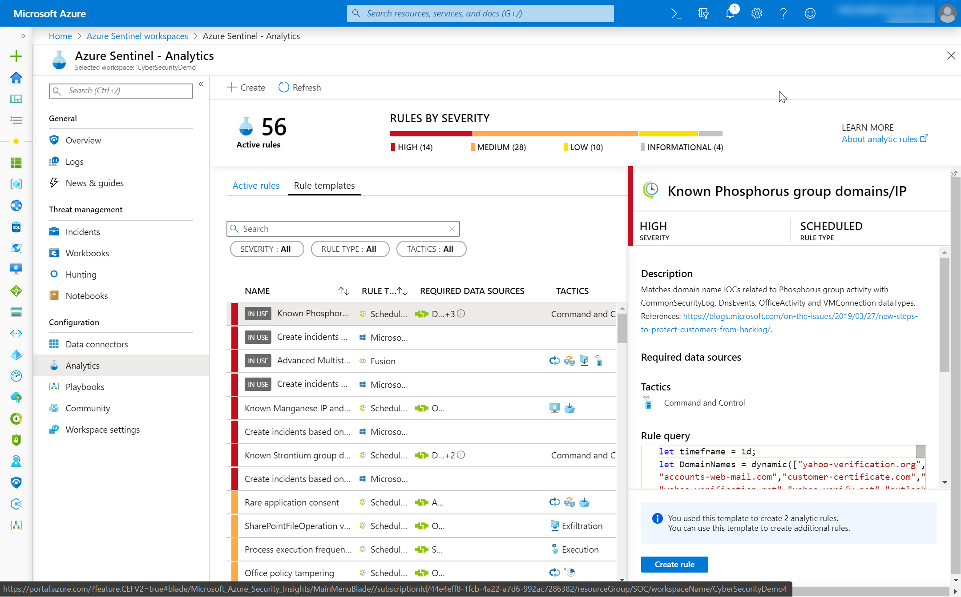
Analytics
You got data… now what?
Create Analytics to detect suspicious activity!
Enable Microsoft Security rules
Enable built-in rules
Use GitHub
Build custom detections

Slide 20
Built-in rules

Slide 21
Custom rules creation

Slide 22
Demo
Authoring custom rules

Slide 23
Alerts and automated threat response

Slide 24
Demo
API integrations with Microsoft Security Graph

Slide 25
Visualize

Slide 26
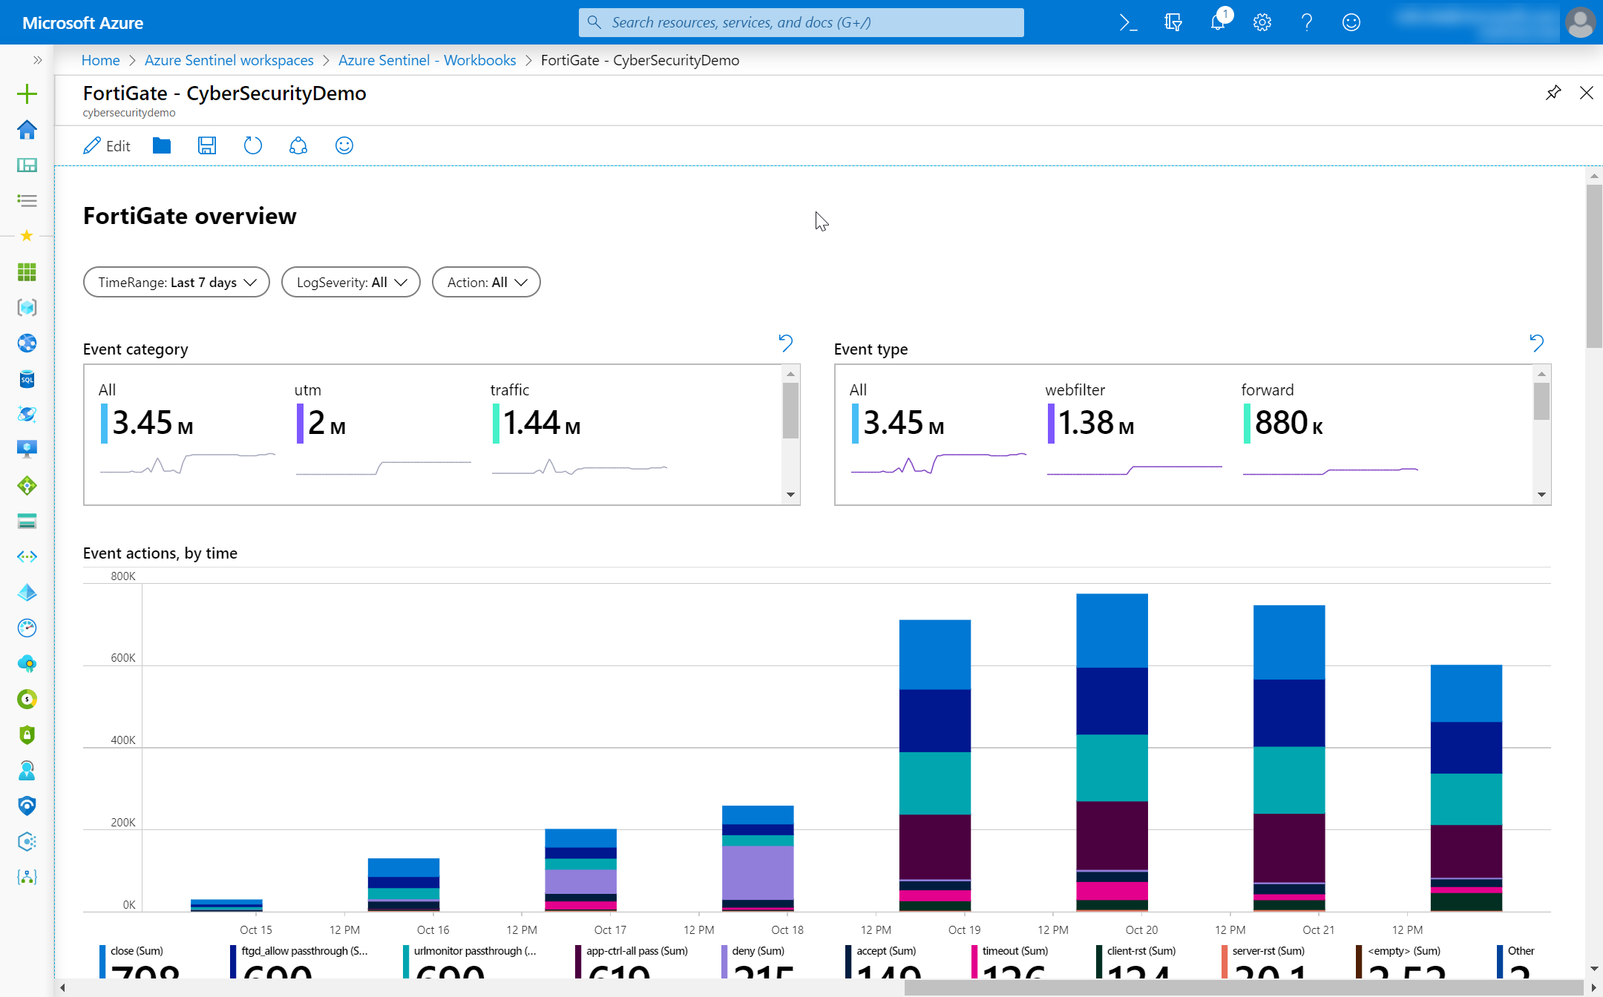
Data visualization
Monitor your data and activity
Use built-in workbooks
Use Power BI for external users

Slide 27
Create custom workbooks

Slide 28
Demo
Creating a custom workbook using Azure Monitor workbooks

Slide 29
Security orchtestration

Slide 30
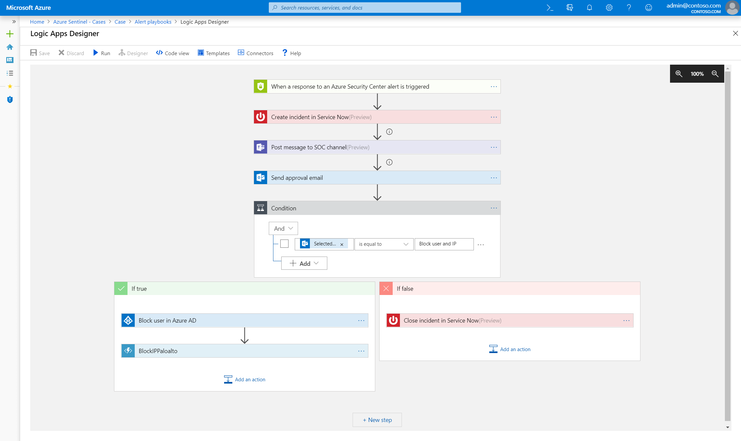
SOAR
Reduce your workload with automation
Use GitHub templates
…. and share your workbooks back!

Slide 31
Demo
Automating incident response with playbooks

Slide 32
Thank you.
Notes:
Thanks for listening to Securing your Infrastructure with Azure Sentinel.
My name is [Speaker name].

